Slide 2
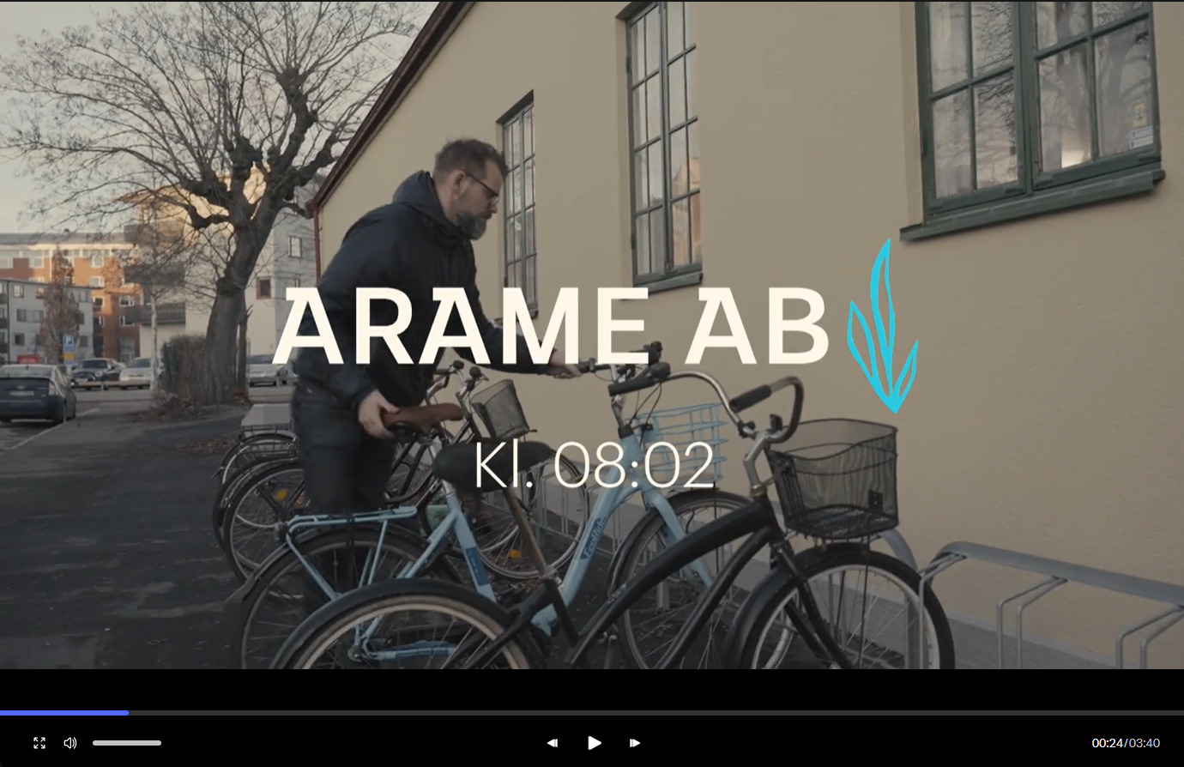

Slide 4
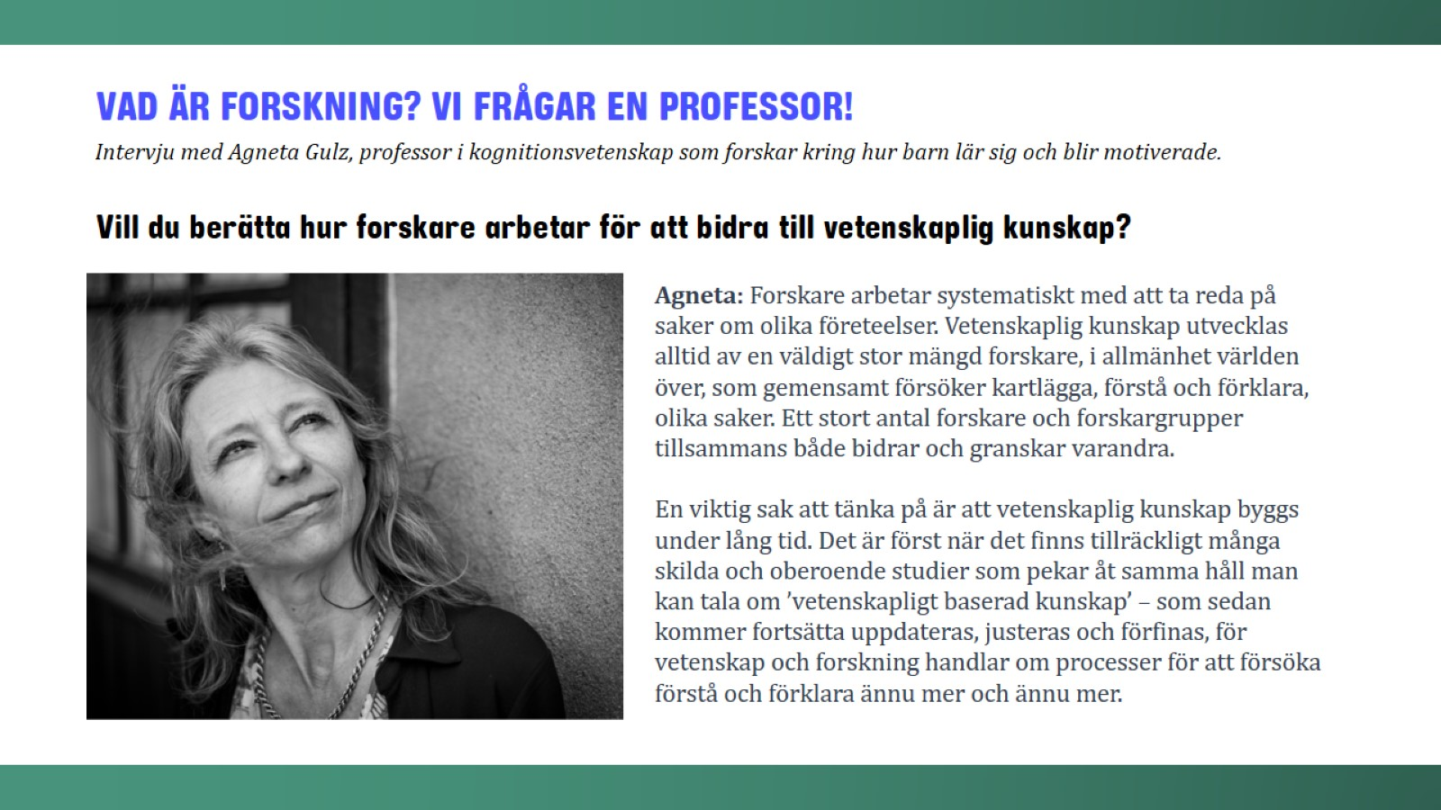

Slide 34
Notes:
http://sagohuset.nu/fakenews

Slide 35
Notes:
http://sagohuset.nu/fakenews

Slide 49
